Slide 1

ETEC-303 Digital Communication Lecture - 7
Instructor:
Abhishek Gagneja
Digital Communication Slides

Slide 2
Non Uniform Quantization
If the distribution of the input voltage in the original signal is not uniform, the smaller voltage levels will face larger error.
E.g.
Assume a full-scale voltage of 10V and that the actual resolution is +/- 4mV (i.e. ∆ = 8mV).
When the signal is close to 10V, the peak quantization error is in the neighborhood of (4mV / 10V ) * 100% = 0.04%.
When the signal level hovers around 10mV , the error is in the vicinity of (4mV / 10mV) * 100% = 40% !!!
Digital Communication Slides

Slide 3
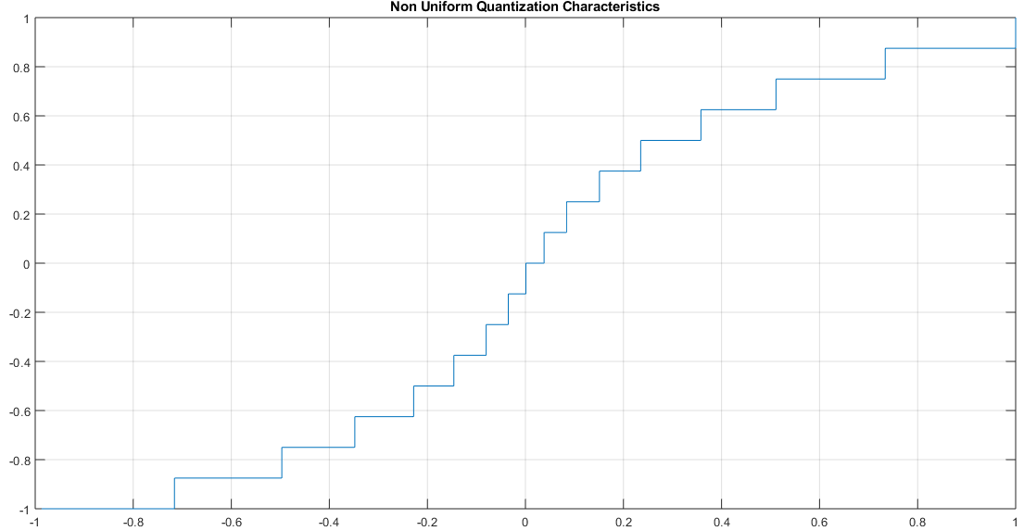
Non-Uniform Quantization
Digital Communication Slides

Slide 4
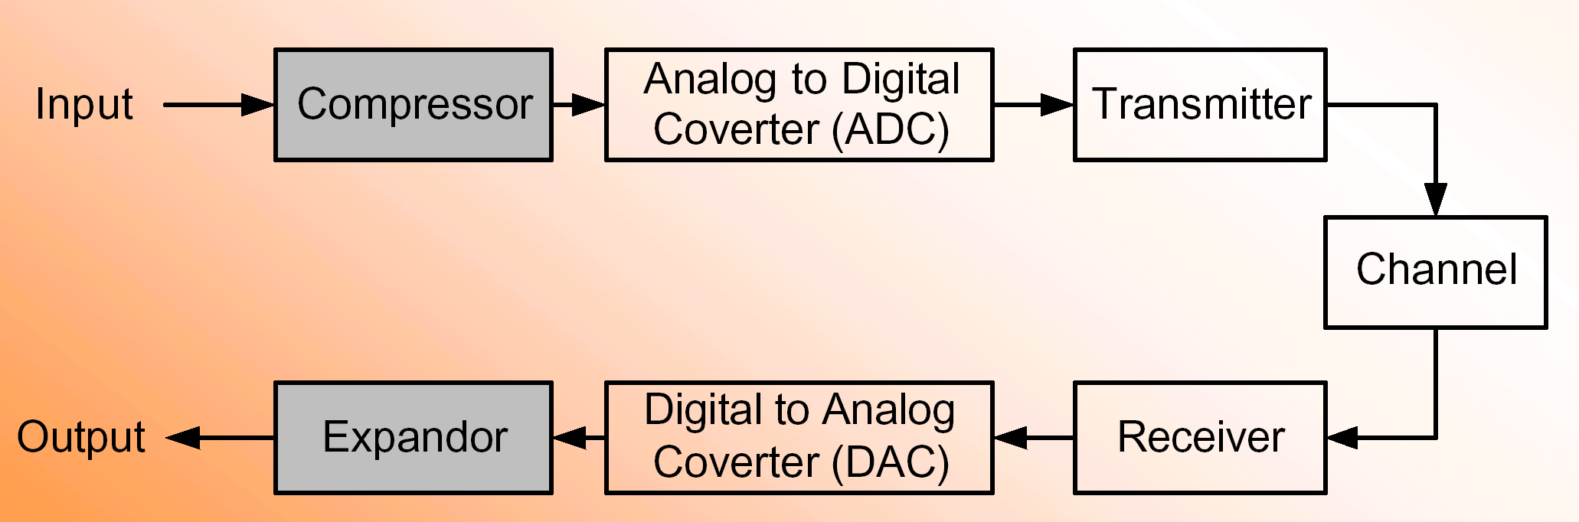
Solution - Companding
Companding is a method of reducing the number of bits required in ADC while achieving an equivalent dynamic range or SQNR. In order to improve the resolution of weak signals within a converter, and hence enhance the SQNR, the weak signals need to be enlarged, or the quantization step size decreased, but only for the weak signals. But strong signals can potentially be reduced without significantly degrading the SQNR or alternatively increasing quantization step size. The compression process at the transmitter must be matched with an equivalent expansion process at the receiver
Digital Communication Slides

Slide 5
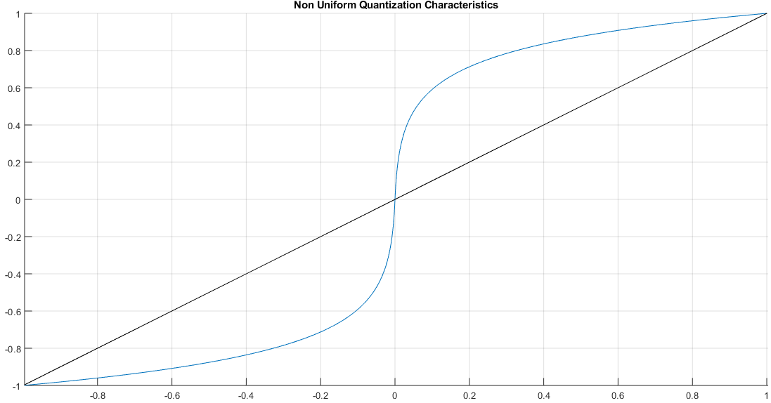
Companding
Digital Communication Slides

Slide 6
Companding
Basically, companding introduces a nonlinearity into the signal
This maps a nonuniform distribution into something that more closely resembles a uniform distribution
A standard ADC with uniform spacing between levels can be used after the compandor (or compander)
The companding operation is inverted at the receiver
There are two standard logarithm based companding techniques
US standard called µ-law companding
European standard called A-law companding
Digital Communication Slides

Slide 7

Types of Companding μ -Law Companding - Standard (North & South America, and Japan)
where
x and y represent the input and output voltages
μ is a constant number determined by experiment
In the U.S., telephone lines uses Companding with μ = 255
Samples 4 kHz speech waveform at 8,000 sample/sec
Encodes each sample with 8 bits, L = 256 quantizer levels
Hence data rate R = 64 kbit/sec
μ = 0 corresponds to uniform quantization
Digital Communication Slides

Slide 8



A-Law Companding - Standard (Europe, China, Russia, Asia, Africa)
where
x and y represent the input and output voltages
A = 87.6
A is a constant number determined by experiment
Digital Communication Slides

